Slide 1
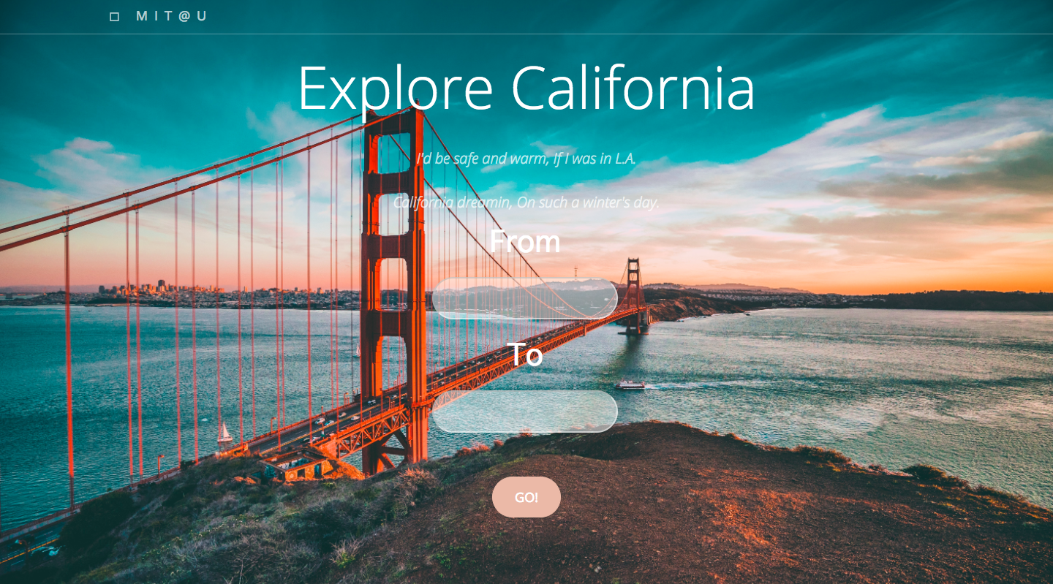
CAPP 30122 Project – Explore California

Slide 2
Introduction
The goals:
Providing the best attraction route for users based on their departing place and destination
The information about attractions are collected from Tripadvisor
Recommended attractions are selected according to their number of reviews and rating on Tripadvisor
For each attraction, we classify it to different groups based on phrases extracted from reviews by natural-language processing

Slide 3
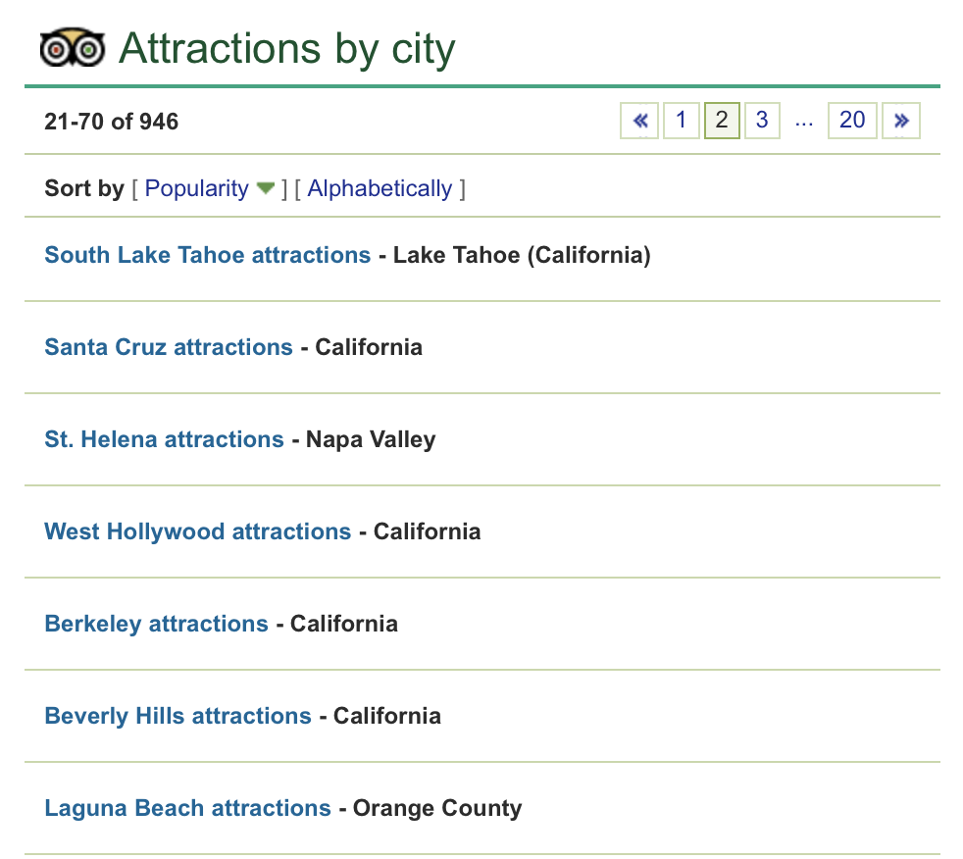
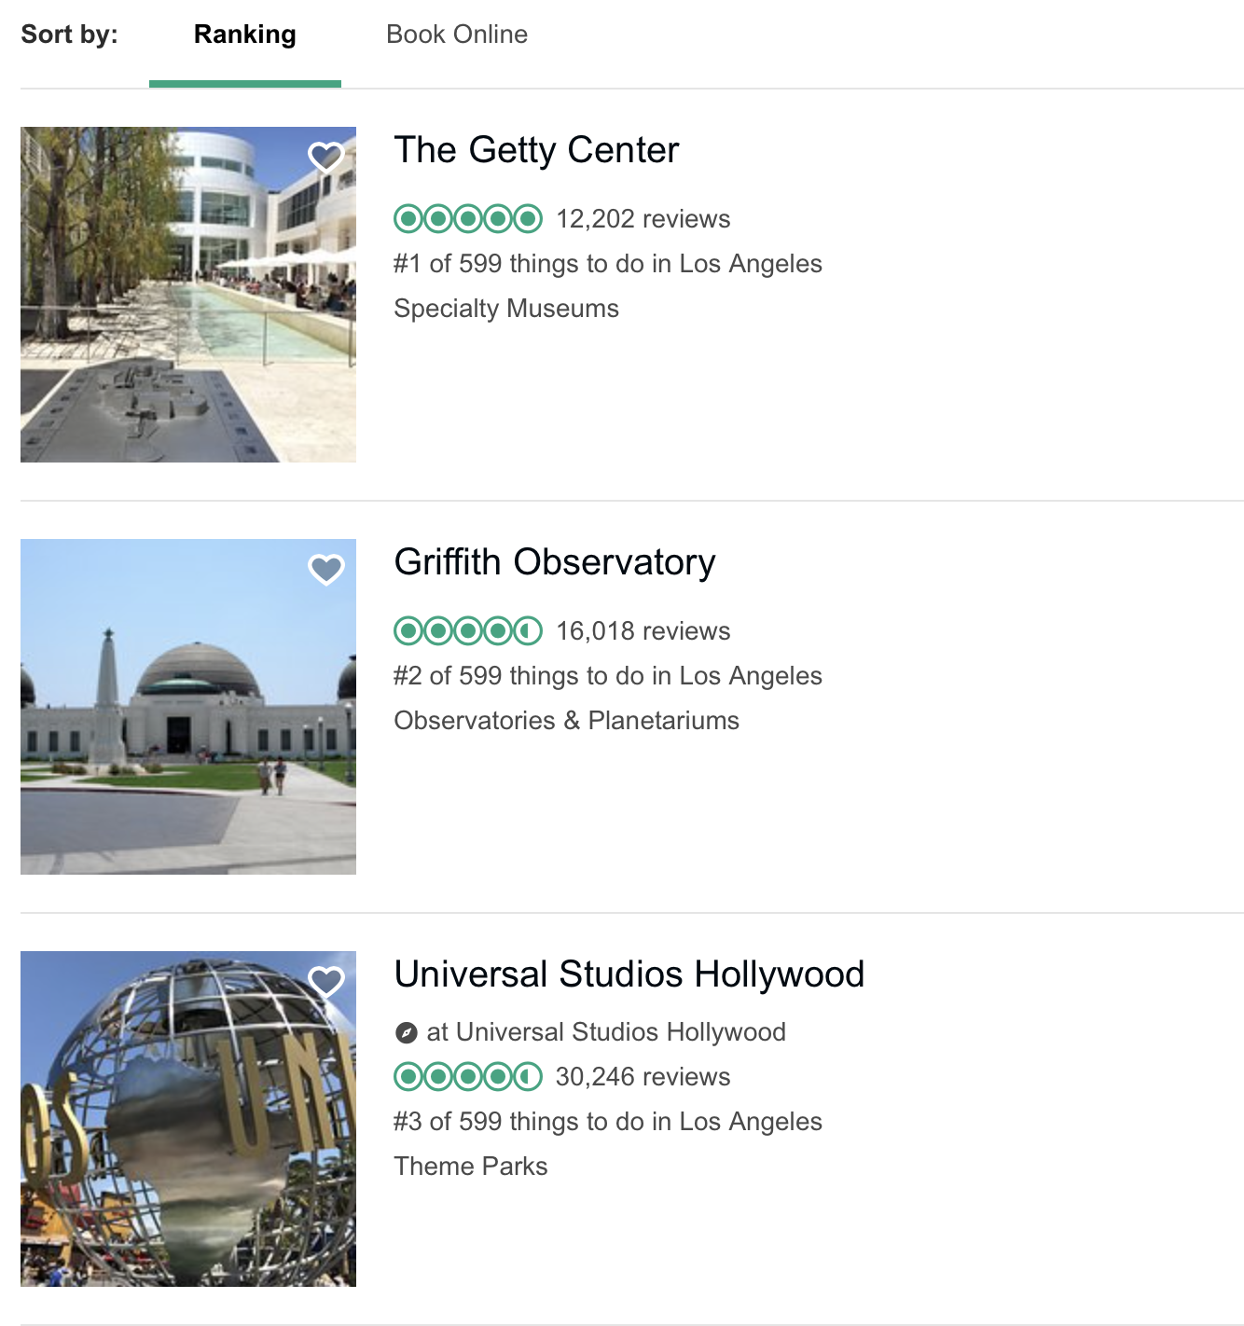
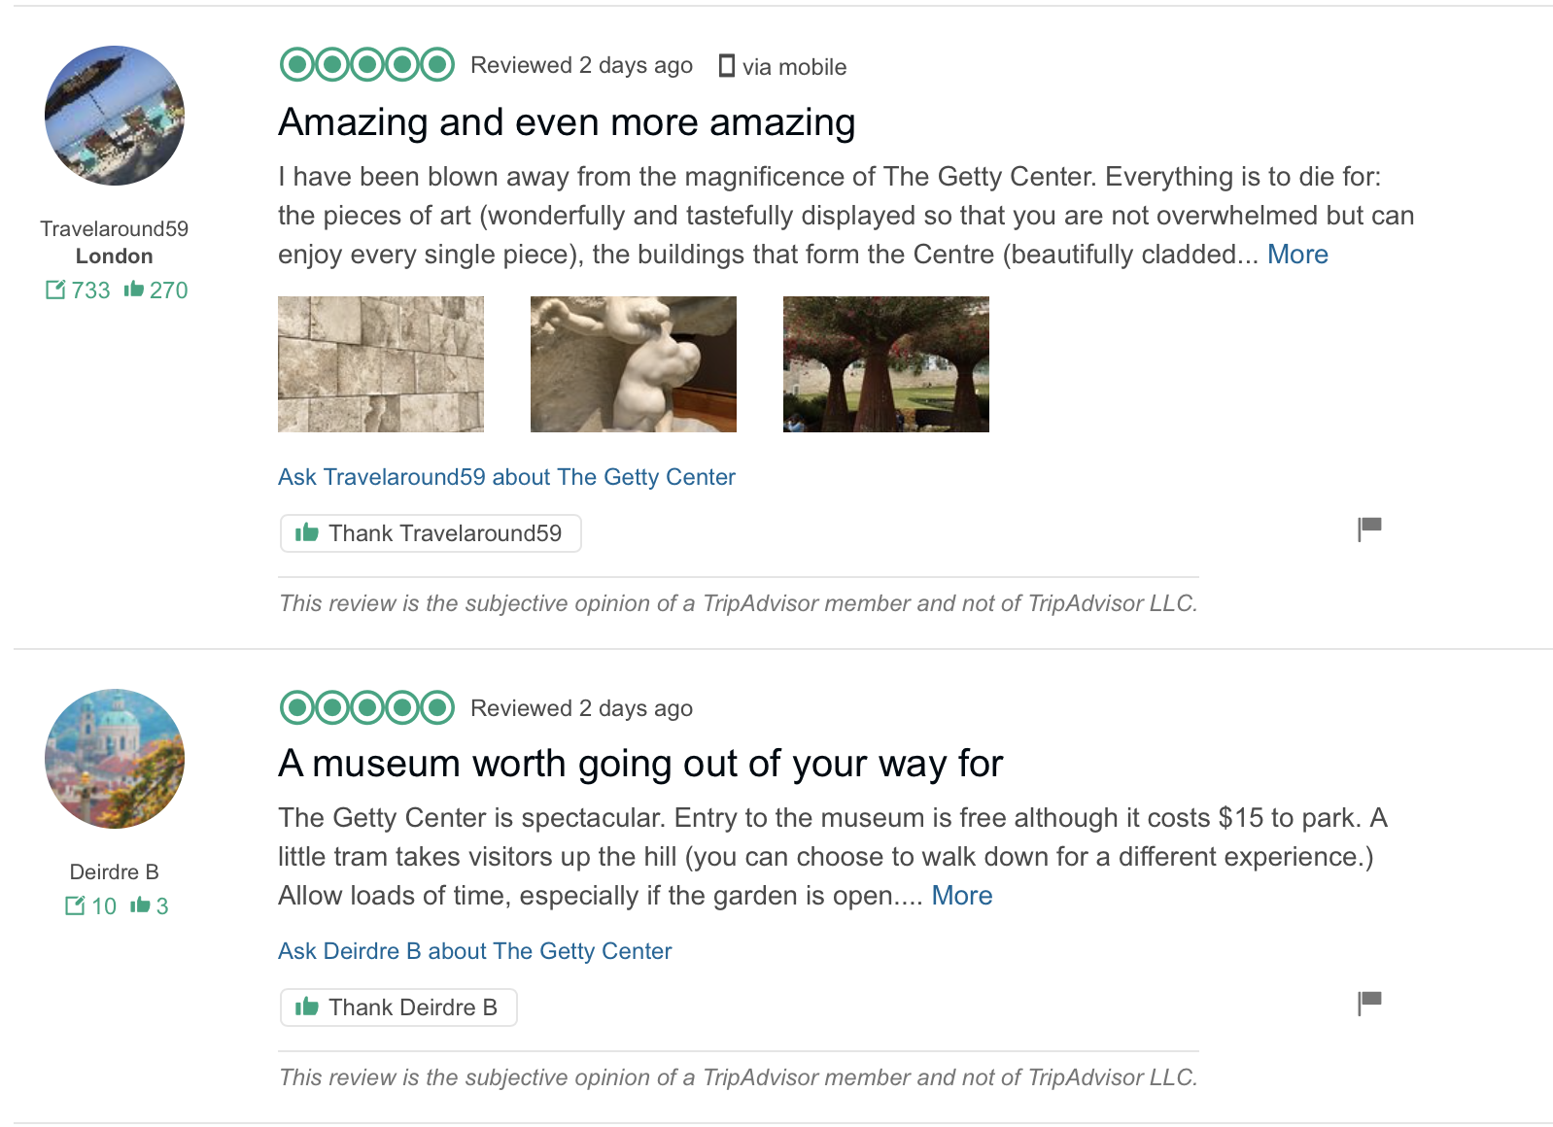
Data Collection : scrape tripadvisor
California → City → Attraction
Tools: Beautiful Soup and Selenium

Slide 4
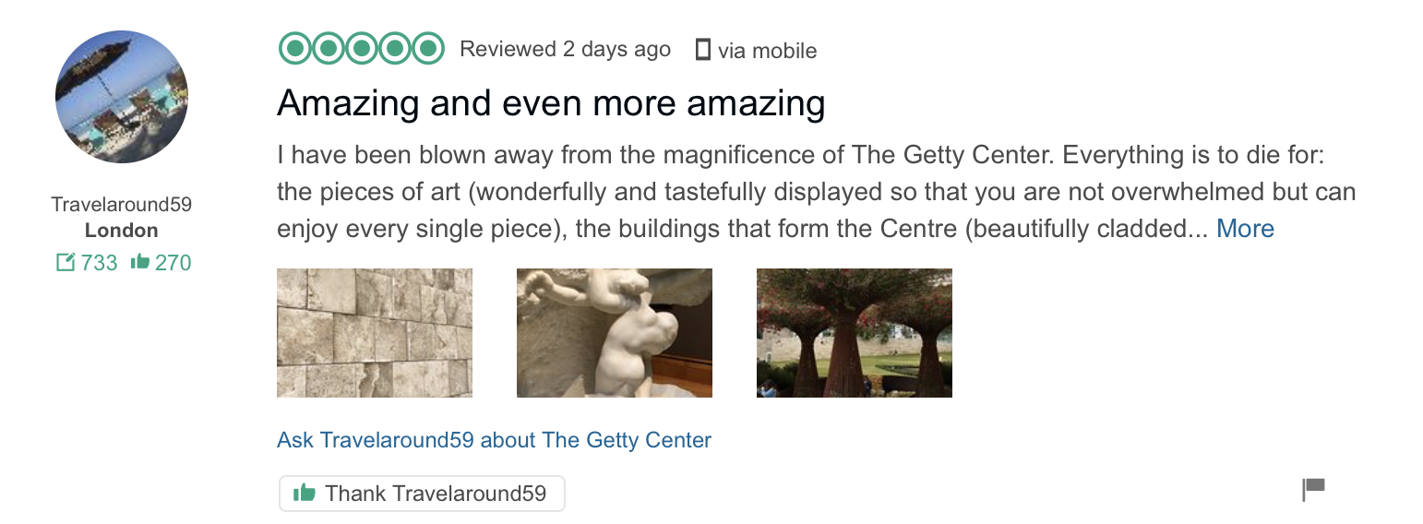
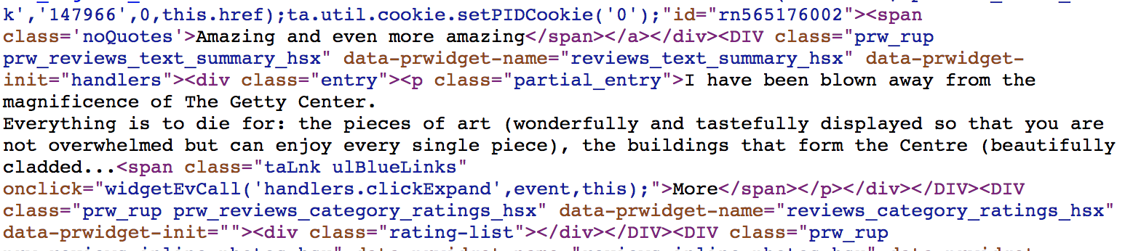
Data Collection : scrape Tripadvisor
Problems encountered:
Tripadvisor has an anti-crawler system:
Only 10 reviews are presented each page – it takes time for our crawler function to wait for page completely uploads
import python time and let our crawler function to sleep for a sec before visiting another page
Reviews are partially displayed in the website so beautiful soup cannot scrape them all
e.g.
Selenium: selenium can automates browsers – basically it can simulate nearly all mouse operations
We mimic the click “more” and turn page operations

Slide 5
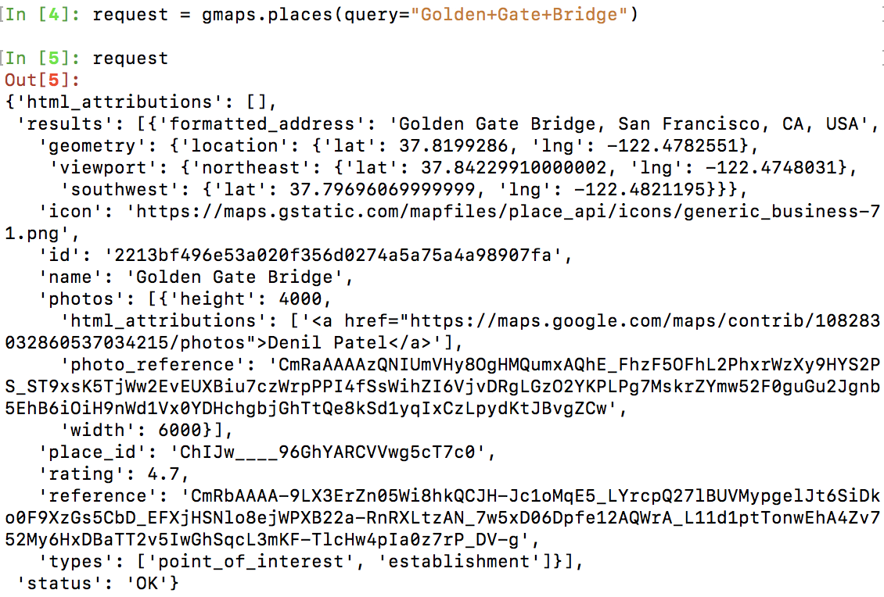
Google MAP API
Google Places API Web Service
Text search request function
we collect some geometric information for each attraction
Google Maps Directions API
Search for the optimal route from our origin and destination
Determine the nearby attractions along the route
Embed the google map to our website and set the nearby
attractions as the waypoint
Quality Control
Set exceptions for google map api request does not response
or any error occurred in the response

Slide 6
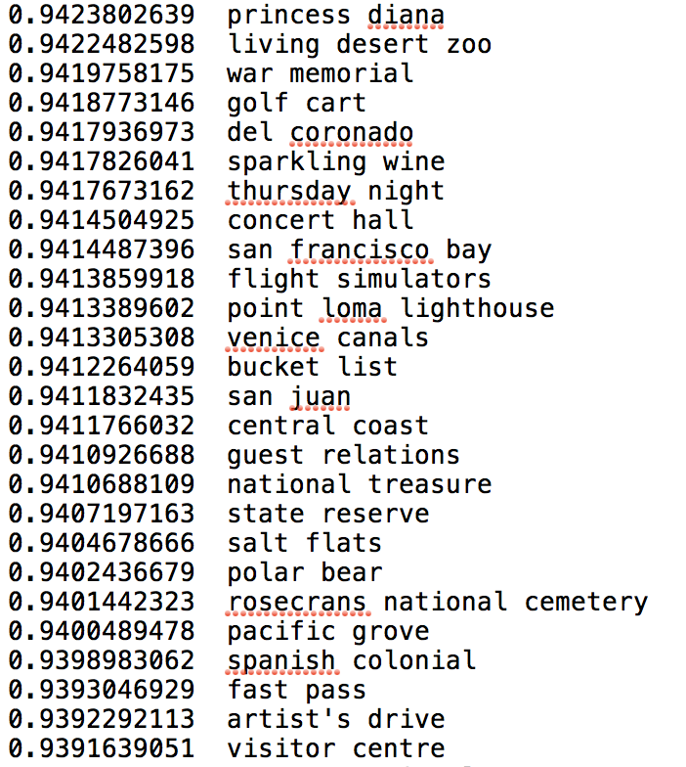
NLP step 1
Phrases as raw material
We tried the approach from the paper
“Mining Quality Phrases from Massive Text Corpora”, by Liu et. al. at the University of Illinois and Microsoft.
An open source implementation of their algorithm called AutoPhrase .
200 * 189 reviews as input
17,675 potential phrases in totoal
We used a threshold of 0.5 for phrasiness, which reduced the list to approximately 2670 potential phrases
how likely
to be a phrase
phrases
Notes:
What we want to achieve is to extract key words/ features from reviews of each attraction and cluster attractions according to their features.
Since single words cannot fully express a feature, we want to extract phrases instead.
We tried...
As we can see, the phrases can show some features of the attractions. For example, “sparkling wine” indicate that travelers can expect to taste some sparking wine at the attraction.

Slide 7
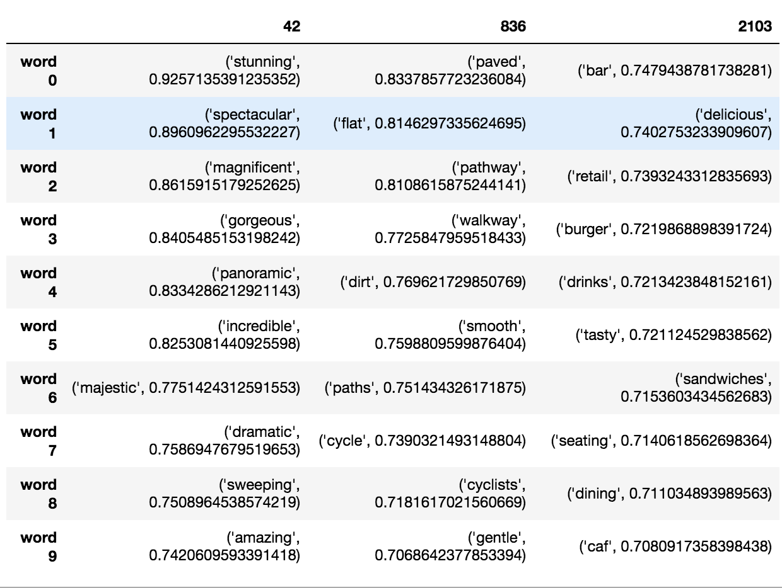
NLP step 2
word2vec algorithm:
find neighbor words
The word2vec algorithm from Mikolov and other Google researchers is perfect for this case.
Given a corpus of text, it maps each word into a numerical vector of say 300 dimensions. The mapping is done in a way that put words that are used in a similar way in the corpus are near each other in the vector space.
Again, take 200 * 189 review text as training data, and build a word2vec model.
fantastic
pathways
restaurant

Slide 8
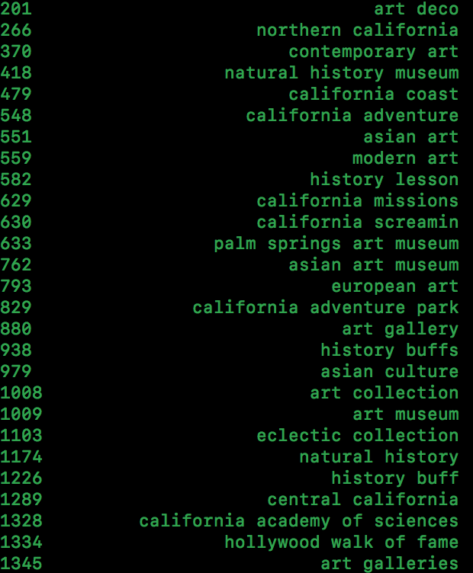
NLP step 3
Clustering phrases into tight topics
agglomerative clustering routine in the python sklearn.
We cluster phrases from what we get from step1, and get not ideal results. Ideally, combine the neighbor words from step2 with phrases from step1 and then cluster them.
The overall combination process forms a tree of nodes.
These clusters can be treated as general features for different kinds of attractions and can enable users to choose the kind they prefer.
Eg. Treat the tree node No.14 as a feature abnd name it “golf”.
pebble beach golf club
11
torrey pines golf course
pebble beach golf course
pebble beach golf
13
14
A golf course
The golf courses
10
A golf
golf courses
12
golf club
the golf

Slide 9
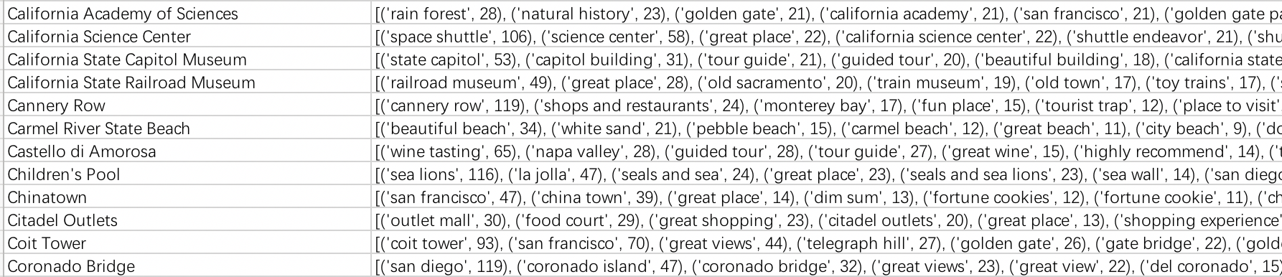
NLP step 4
Match phrases to attractions
Learn from PA5:
Hash table
Find the attractions that frequently mention the phrases in a cluster. These attractions would be the member of the collection formed by a given cluster.

Slide 10
Demo
Select 20 attractions: number of reviews and rating
Pin down the attractions on Google Map: the map is inserted by using ‘waypoints in directions’Google Map API
Each attraction is linked to its Tripadvisor page; classified into different‘phrases groups' such as beautiful beach, great views, etc.

